Slide 1
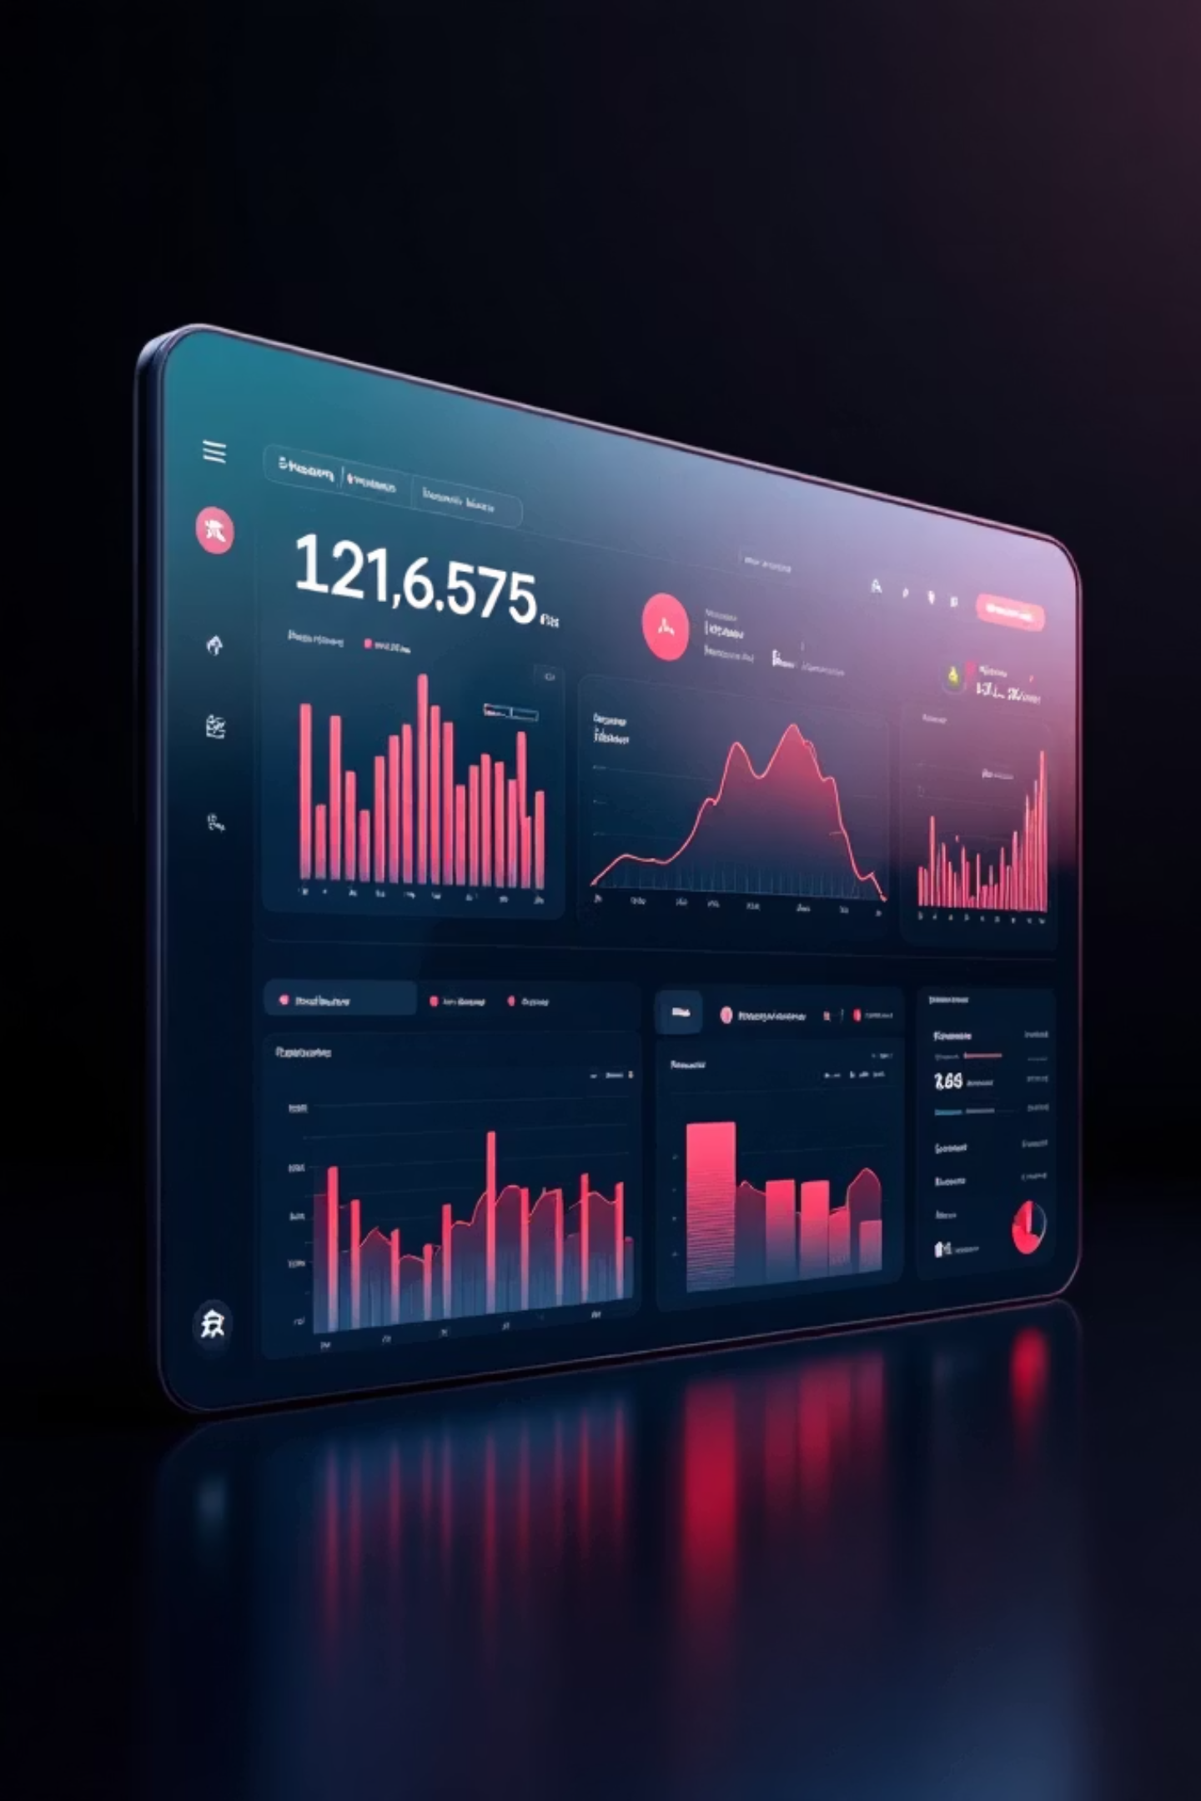
Netflix User Engagement & Subscription Analysis
SQL-Based User Engagement & Subscription Analysis
Tools Used: SQL, Python, PowerBI, Excel

Slide 2

Problem Statement
Project Objective
01
Analyze user engagement, subscription behavior, and content performance to identify revenue optimization opportunities.
Identify High-Value Plans
Determine which subscription tiers drive engagement
02
Content Quality Impact
Understand how content ratings influence retention

Slide 3

Dataset Overview
Multiple data sources integrated for comprehensive analysis:
Users
Watch History
Demographics, subscription plan, spend, active status
Sessions, duration, device, ratings
Movies
Search Logs
Metadata, genre classifications
User search behavior patterns
Recommendations
Reviews
Personalization engine outputs
Movie ratings and feedback

Slide 4
Key Metrics
1
2
Total Watch Minutes
Average Watch Duration
By subscription plan tier
Per user engagement analysis
3
4
Monthly Spend
Rating by Genre
Average revenue by plan
Content quality assessment
5
6
Hidden Gems
Completion Rate
High ratings, low views identification
Content finishing percentage

Slide 5
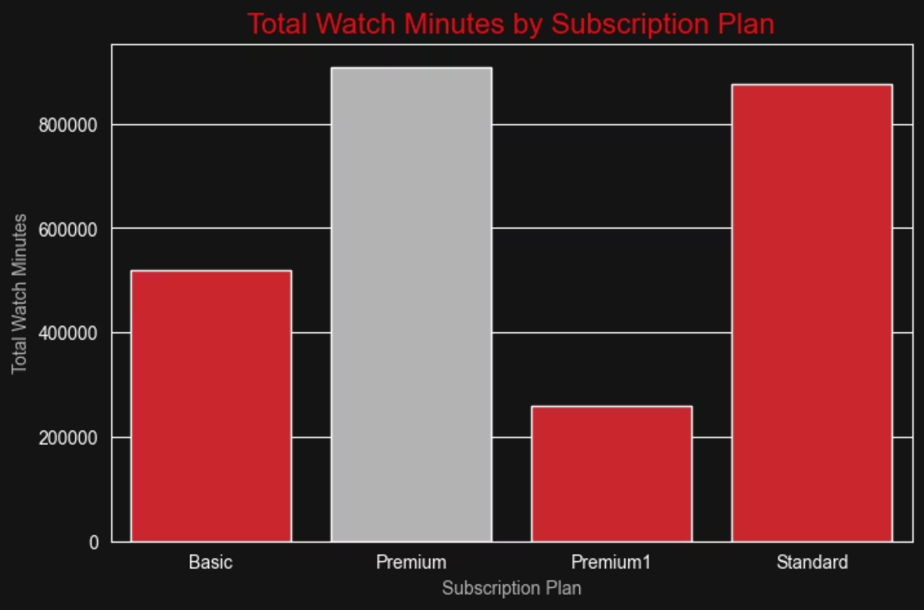
Subscription vs Engagement
Premium users generate the highest total watch time, demonstrating strong alignment between higher-tier plans and engagement levels.
The data reveals a clear correlation: as subscription tiers increase, so does total watch time. Premium subscribers watch over 3.6x more content than Basic plan users.

Slide 6

Content Performance Insights
Hidden Gems Identified
Analysis revealed high-rated but under-viewed movies, indicating content discovery inefficiencies in the recommendation system.
High-rated films with low view counts
Discovery mechanisms need optimization
Personalization signals may be underutilized
These findings suggest that content quality doesn't automatically translate to viewership, highlighting a critical opportunity for improved recommendation algorithms.

Slide 7

Engagement Distribution Analysis
50%
Top 20%
Average Completion Rate
Watch Time Concentration
Only half of started content is finished
High engagement among select users
Watch time is heavily concentrated among top users, indicating significant personalization opportunities for mid-tier and lower-engagement segments.

Slide 8

Device & Regional Analysis
Engagement patterns vary significantly by device type and geographic region, creating targeted optimization opportunities.
Device Performance
Mobile, tablet, and desktop usage show distinct engagement patterns requiring tailored experiences
Regional Differences
Watch intensity varies by country, suggesting localized content strategies

Slide 9
Key Business Insights
Premium Plans Drive Engagement
Hidden Gems Underutilized
Higher-tier subscriptions show strongest correlation with watch time
High-quality content isn't reaching appropriate audiences
Engagement Imbalance
Moderate Completion
Top users dominate watch time, leaving room for broader engagement
Only 50% completion rate suggests content or recommendation issues

Slide 10



Strategic Recommendations & Business Impact
Promote Hidden Gems
Upgrade Incentives
Personalization
Surface high-rated under-viewed content
Target engaged lower-tier users
Improve behavioral signals
+25%
+15%
+20%
Watch Time
Retention
ARPU
Projected increase
Expected improvement
Revenue growth potential
Data-driven strategies unlock additional revenue growth through improved personalization and content discovery optimization.

